Slide 1
First Time Sphero Edu Users

Slide 2
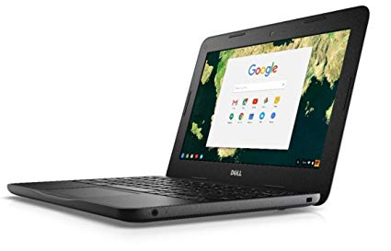
Step 1
Login to Chromebook

Slide 3
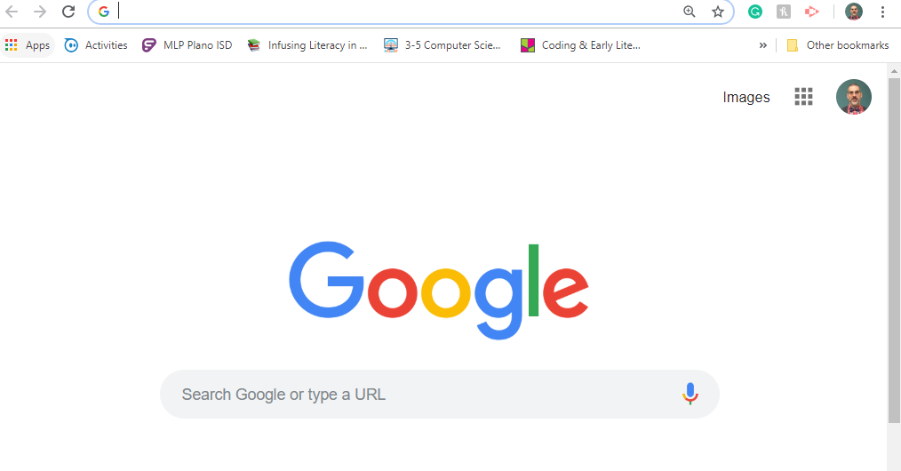
Step 2
Open Chrome Browser

Slide 4
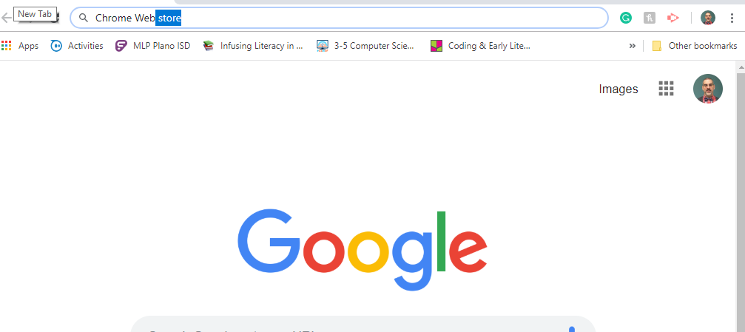
Step 3
Search for Chrome Web Store.
Do NOT go to Webdesk.

Slide 5
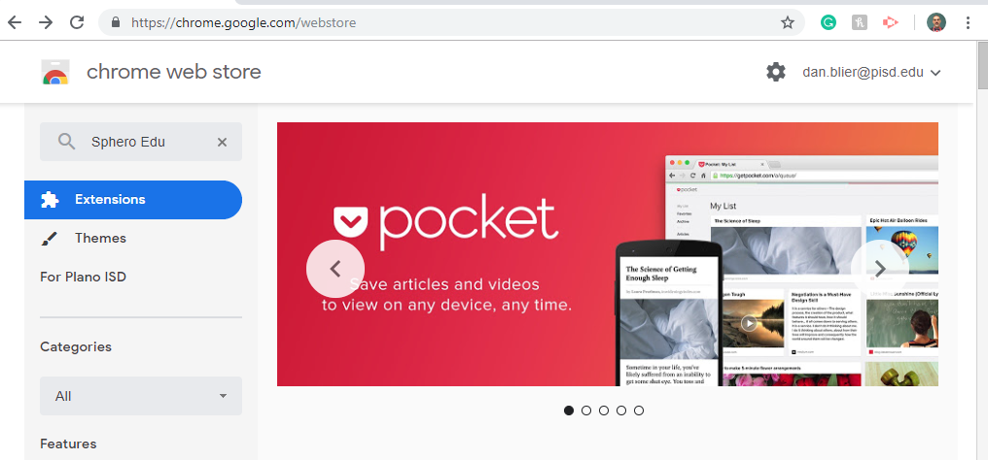
Step 4
Search for Sphero Edu

Slide 6
Step 5
Click on Launch App. This will install Sphero Edu app on the Chromebook.

Slide 7
Step 6
Once installed the Sphero Edu should launch.
Pick out a SPRK+
Click on “Connect Robot” in the bottom right corner of your screen.

Slide 8
Step 7
Find the SK-#### on your SPRK+ and click on the matching SK-#### on the screen.

Slide 9
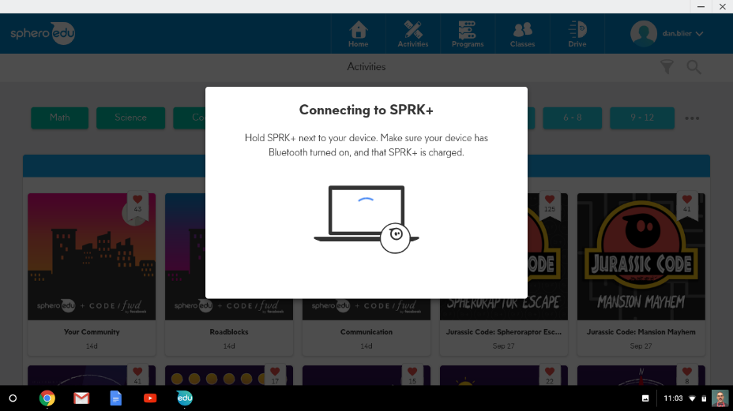
Step 7B
If your Chromebook doesn’t connect, close out Sphero Edu.
Relaunch Sphero Edu.
This usually solves the issue.
If not, refer to the Sphero SPRK+ Troubleshooting Guide

Slide 10
Step 8
Once installed the Sphero Edu should launch.

Slide 11
Step 9
Click on Sign In.
Click on Sign In with Google.
Sign In using Plano ISD login1@mypisd.net and password

Slide 12
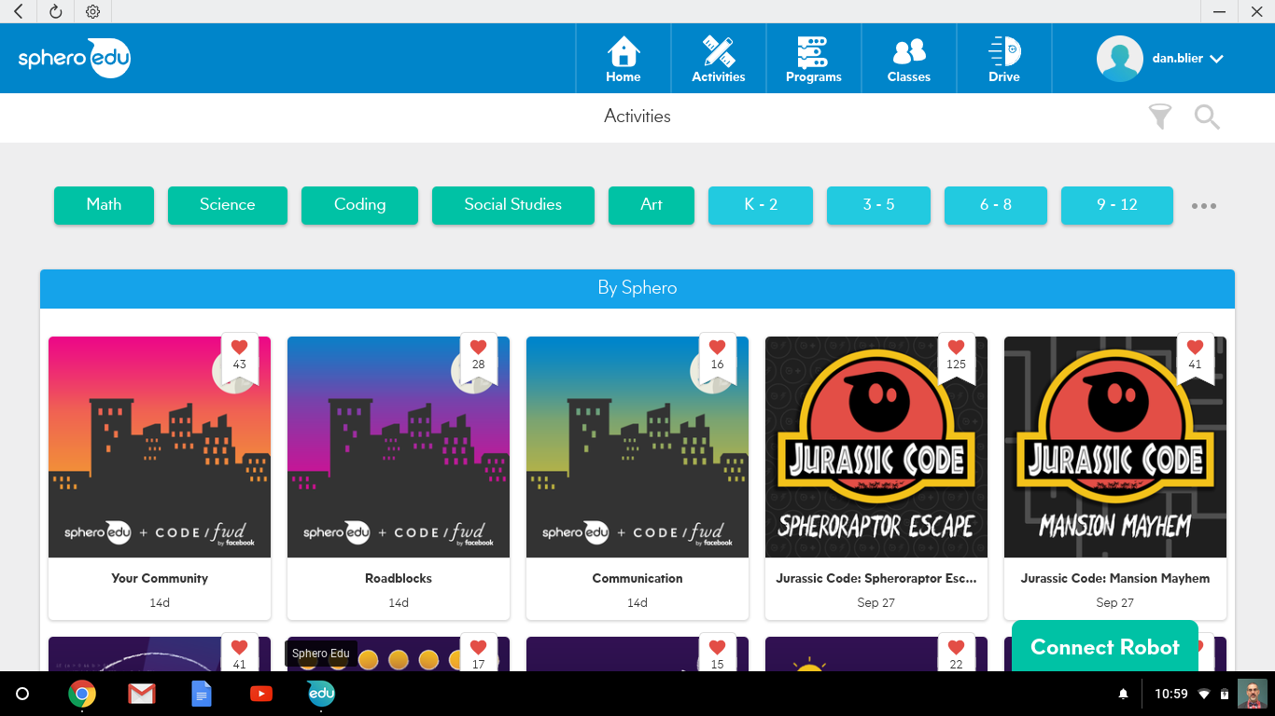
Step 10
Click on Connect Robot on the bottom right corner of your screen

Slide 13
Step 11
Start first time users on Draw 1.
Using the search feature, search for “Draw 1”

Slide 14
Step 12
Select the Draw 1 activity.

Slide 15
Step 13
Select Start Activity at the top of the page

Slide 16
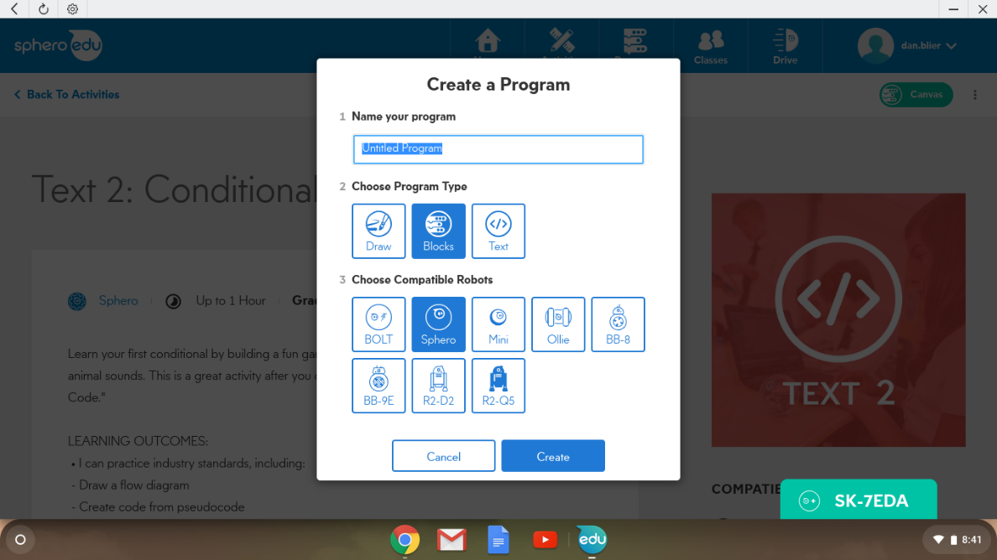
Step 14
Name your project
Select Draw
Select SPRK+
Click on Create

Slide 17
Step 13
Click on “Canvas” on the top right of your screen.

Slide 18
Step 15
On the left side of your window are your instructions that are either written or in video format.
As you complete each step, click on Mark Complete.

Slide 19
Step 15
On the right side of your window is the canvas. This is where your work will be completed. You can draw, use blocks, or type text code.
When you are ready to test the code, put your SPRK+ on the floor and then click on Start in the middle of your screen.

